Slide 1
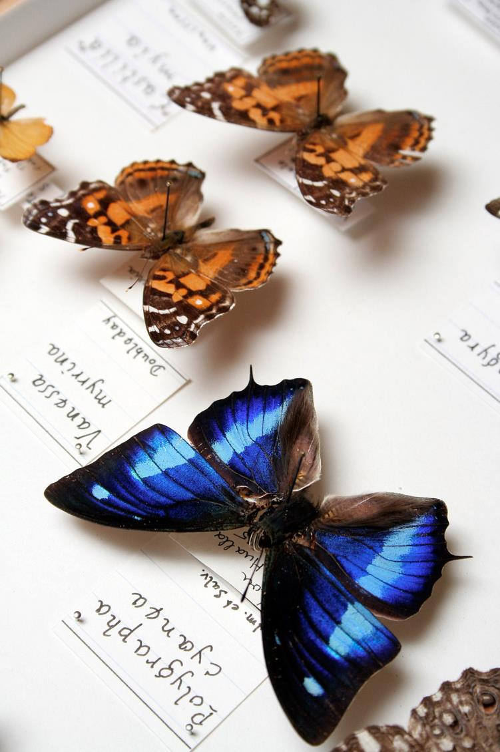























©Natural History Museum London – CC BY
Dimitris Koureas
DiSSCo Coordinator
Director of International Biodiversity Infrastructures
Naturalis Biodiversity Center, Netherlands
@DimitrisKoureas

Slide 2
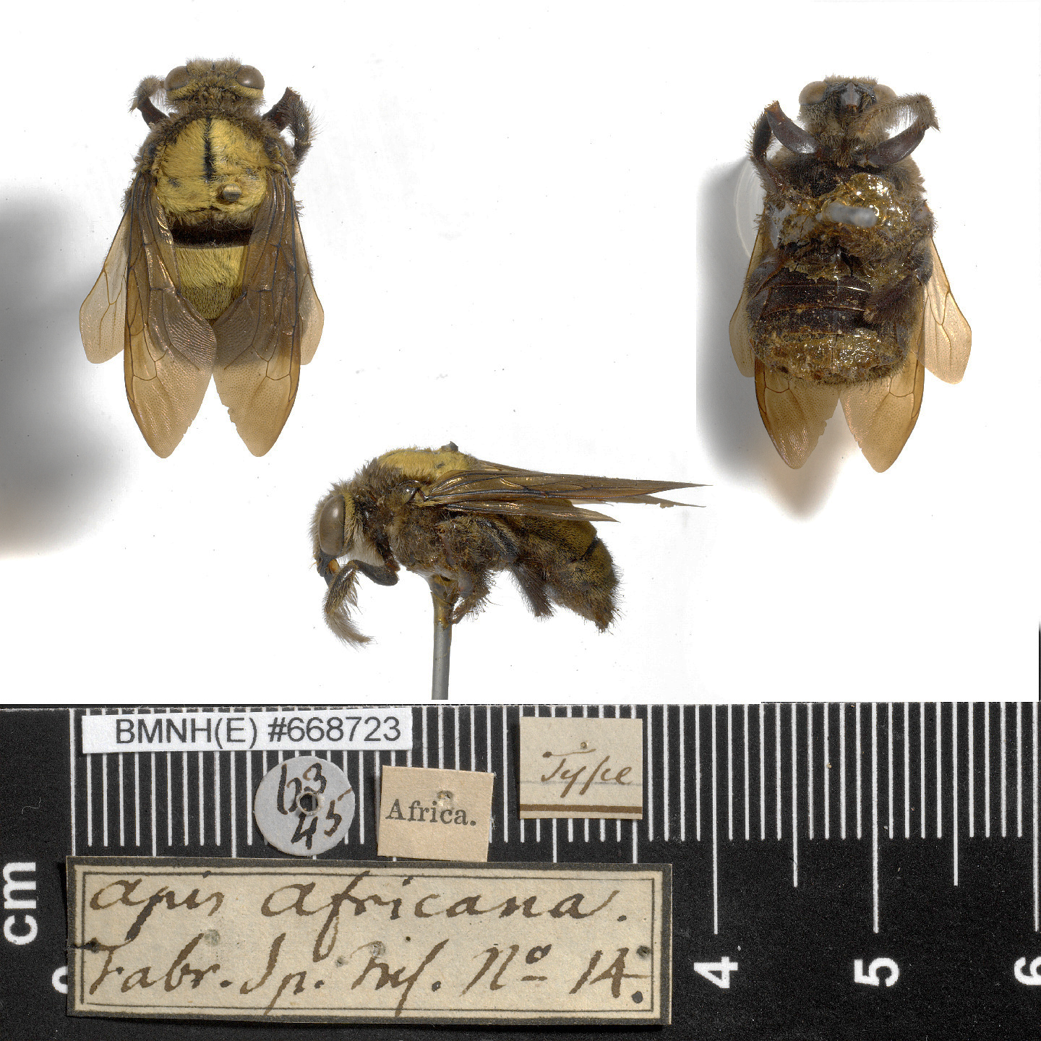
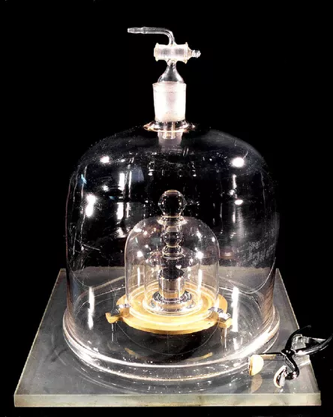
BMNH(E)668723
Apis africana
Type specimen = Standard
Natural Science Collections:
2 million standards
3 Billion objects

Slide 3
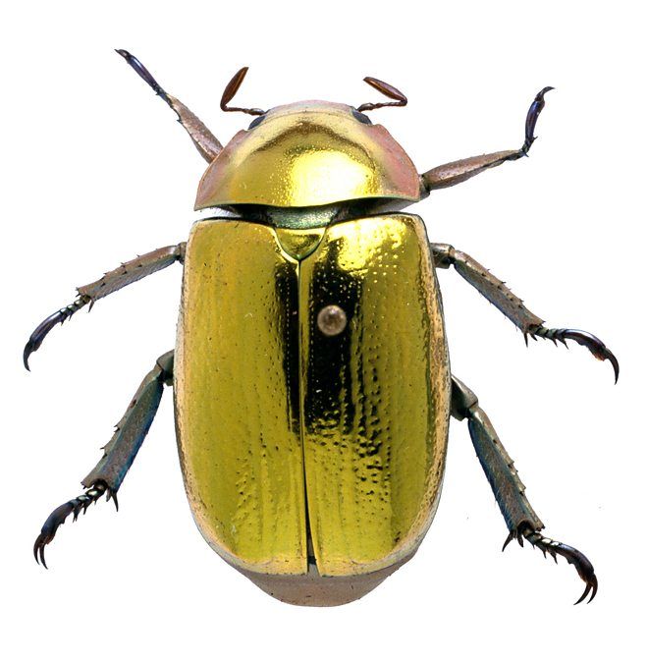




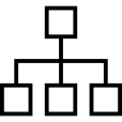


What’s in a Museum specimen?
Genomic data
Biochemical data
Morphological data
Geographical data
Taxonomic Information
Species Interactions data
Ecological data

Slide 4
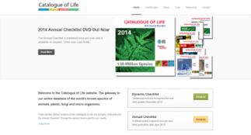
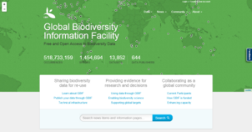
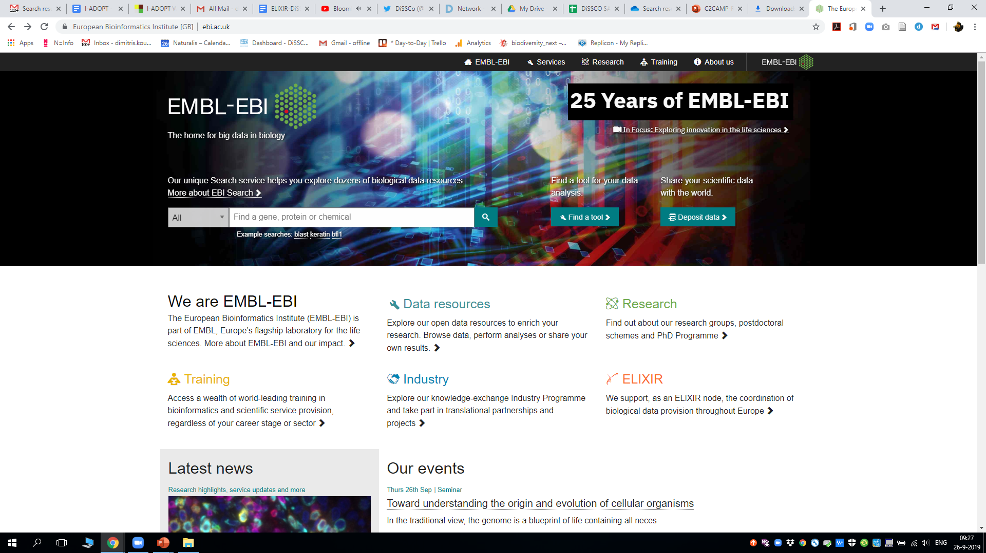
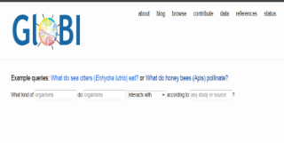

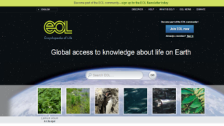
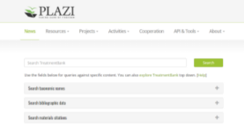
GBIF
Collections-related Data classes
Catalogue of LIfe
Occurrence / Images
Taxonomy
EMBL-EBI
GloBI
Species Interactions
Genomic information
Literature - Treatments
Traits
Plazi – TreatmentBank
Nomenclature
EoL - TraitBank
IPNI / Zoobank

Slide 5
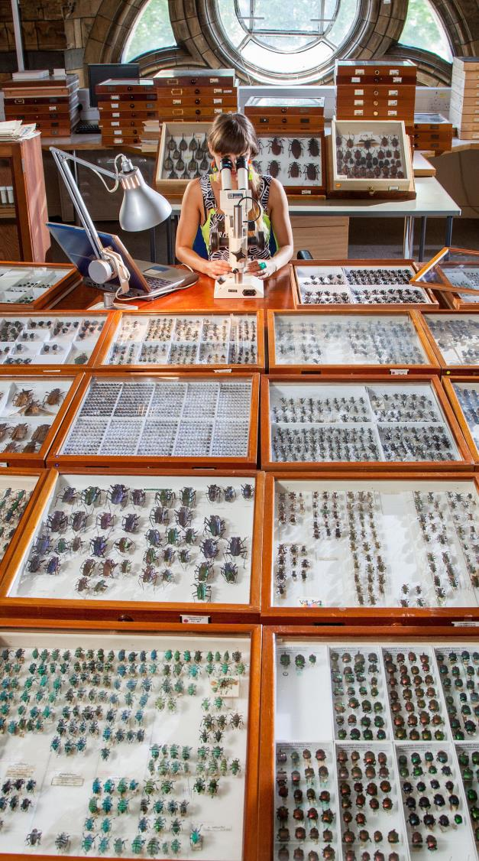
Extended Specimens (Digital Specimen Objects)
Taxon
Interaction
Sequence
Occurrence
Taxon
Concept
All data classes unambiguously linked to the physical objects they derive from
Gene
Specimen
Taxon Name
Collection
Trait
Publication

Slide 6
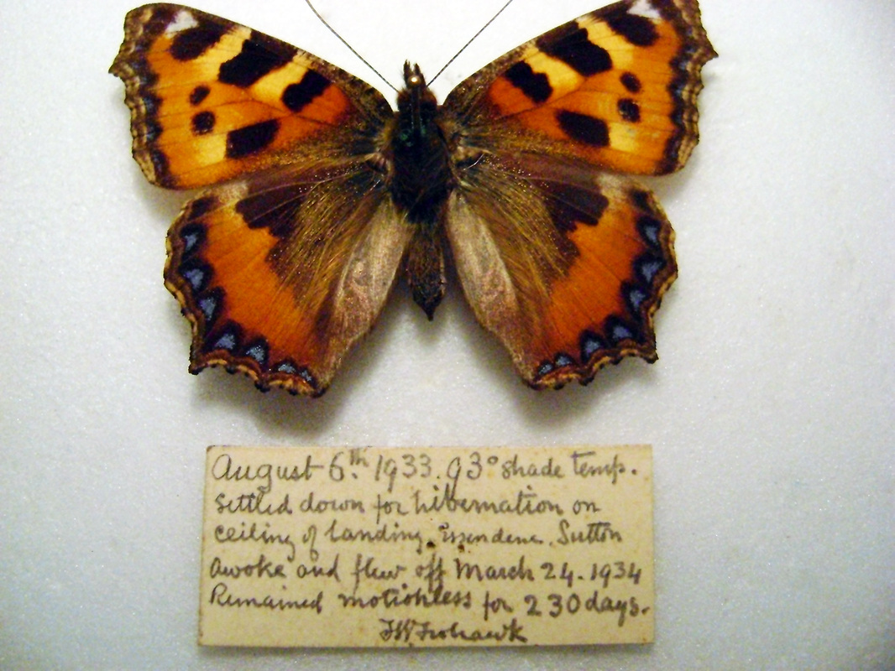
Structure of a Digital Specimen Digital Object (DSDO)
DO, = An envelope
PID
Kernel information (metadata about specimen DO)
metadata₂
… … … … … … …
… … … … … … …
metadata_{N}
… … … … … … …
content_{N}
… … … … … … …
… … … … … … …
… … … … … … …
… … … … … … …
… … … … … … …
PID₁
PID₂
PID…
PID_{N}
Bit sequence
PIDs are pointers that resolve to location (URL) of the item e.g., DO itself, physical specimen, hi-res images, label information, tissue sample, DNA sequence, etc.

Slide 7
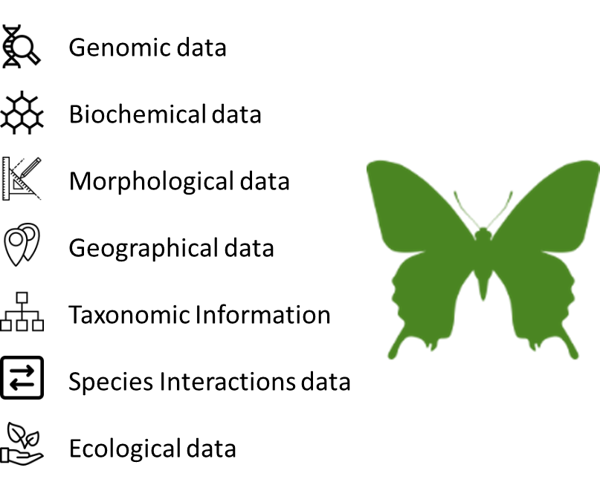
Physical Object
Digital Surrogate
FAIR Digital Object
An actionable knowledge unit

Slide 8
a new business model: ONE EUROPEAN COLLECTION
119 National Facilities
21 Countries
One European Collection of scientific assets
Common Collections development strategy
Economies of scope and scale
Monitoring impact of collections (documenting ROI)
Specialisation strategies (e.g. in alignment with national priorities, e.g. Smart Specialisation Strategies)
Joint Research Agendas
Largest ever formal agreement between natural science collection facilities
Centralised shared governance model already in place
Synchronisation of facilities at access, data and policy level

Slide 9


Unique benefits of implementing a FAIR DO Architecture in Biodiversity
Trust
Reproducibility
Persistent link to the specimen supports validation of observations
Persistent link to the specimen supports validation of observations
New insights
Expert Community
Robust linking of different data types
Community Annotations -
Move the curation space from the analogue to the digital

Slide 10
What we need to do still to grow a FAIR DO Architecture/culture?
Scalable and agile PID
Solutions
Data Type Registries
FAIR DO compliant repositories
Stakeholder Buy-in
Capacity building

